Slide 1

Music Genre Recognition Using CNN
Sumit Shahu 21107004
Pravesh Yadav 21107057
Mustafa Shaikh 21107045
Ankit Purohit 21107020
Project Guide
Prof. Sheetal Jadhav

Slide 2
1. Introduction
Music genre recognition is the task of automatically assigning a genre label to a piece of music.
Convolutional Neural Networks (CNNs) have shown promise in extracting relevant features from audio data for accurate genre classification.
In this presentation, we explore the application of CNNs in creating a robust music genre classifier.
1.1 Motivation:
With the ever-growing volume of digital music, organizing and categorizing music libraries has become increasingly challenging.
Automated music genre recognition can enhance user experience in music streaming platforms, aiding in personalized recommendations.
CNNs offer a data-driven approach to understand the intricate patterns and characteristics inherent in different music genres.

Slide 3
1. Introduction
1.2 Objectives:
To Develop a Music Genre Recognizer using CNN.
To identify patterns and features in sound with the help of MFCC (Mel-frequency cepstral coefficients).
To Perform tasks such as data preprocessing & feature extraction using python library librosa.
To create a user friendly interface for seamless interactions using Django , HTML, CSS & JavaScript.

Slide 4
2. Literature Survey of the existing system
Sr No. | Title | Author | Year | Demerits | Methodology | Result
1. | [1]Fourier Transform Based Music Genre Classifier. | Ahmet Elbir , Hamza Osman, Nizameltin aydin. | 2009 | Fourier Transform-based classifiers can be sensitive to noise in the signal. Since music signals can have background noise or other disturbances, this can lead to inaccuracies in genre classification | Preprocessing audio , applying Fourier transform to extract frequency features, aggregating these features and training a classification model | The result is the model which automatically categorize music into different genre based on features extracted from frequency domain of audio signal

Slide 5
2. Literature Survey of the existing system
Sr No. | Title | Author | Year | Demerits | Methodology | Result
2. | [2]Music Genre Classification Using Neural Network. | Naman Kothari, Pawan Kumar | 2022 | Gathering and labeling a large dataset of music can be time-consuming and expensive, | labels are assigned to musical elements such as genre, mood, and instrumentation. The librosa library, which is based on Python, assists in extracting features and hence in supplying acceptable parameters for network training | The result is audio files will be categorized based on the minimum frequency and other similar characteristics

Slide 6
2. Literature Survey of the existing system
Sr No. | Title | Author | Year | Demerits | Methodology | Result
3. | [3]Music classification using machine learning. | Shubham Sharma , Prasanna Naik | 2021 | Machine learning models trained on a specific dataset may struggle to generalize to new, unseen music samples. | Model implementation using algorithm such as : KNN , SVM , Logistic Regression and Random Forest , Feature extraction methods : filter , wrapper , embedded | Audio input will be categorized into corresponding genre based on similar audio features

Slide 7
3. Limitations of existing systems
Some songs may belong to multiple genres, hence Classifying songs with elements from various genres becomes challenging .
Musical trends and genres evolve over time, and existing classification systems may struggle to adapt to emerging genres or changes in popular styles.
The availability of labelled training data for certain genres may be imbalanced, affecting the model's ability to generalize well across all genres and leading to biased classifications
Advanced models for genre recognition can be slow and may need a lot of computing time and power, making them less suitable for simple devices.

Slide 8
4. Problem statement
Problem Statement:
The complexity arises from the need to develop an algorithm that can effectively analyze various audio features such as rhythm, pitch, and timbre, providing consistent and reliable genre predictions across a wide spectrum of musical styles
The difficulty is in making a flexible model that can understand the small differences in various music styles, guaranteeing accurate genre predictions.
Solution Proposed:
A proposed solution involves implementing a deep learning approach. Convolutional Neural Networks (CNNs) can be employed to automatically learn hierarchical features from audio spectrograms, capturing patterns related to rhythm, pitch, and various outher audio features.

Slide 9
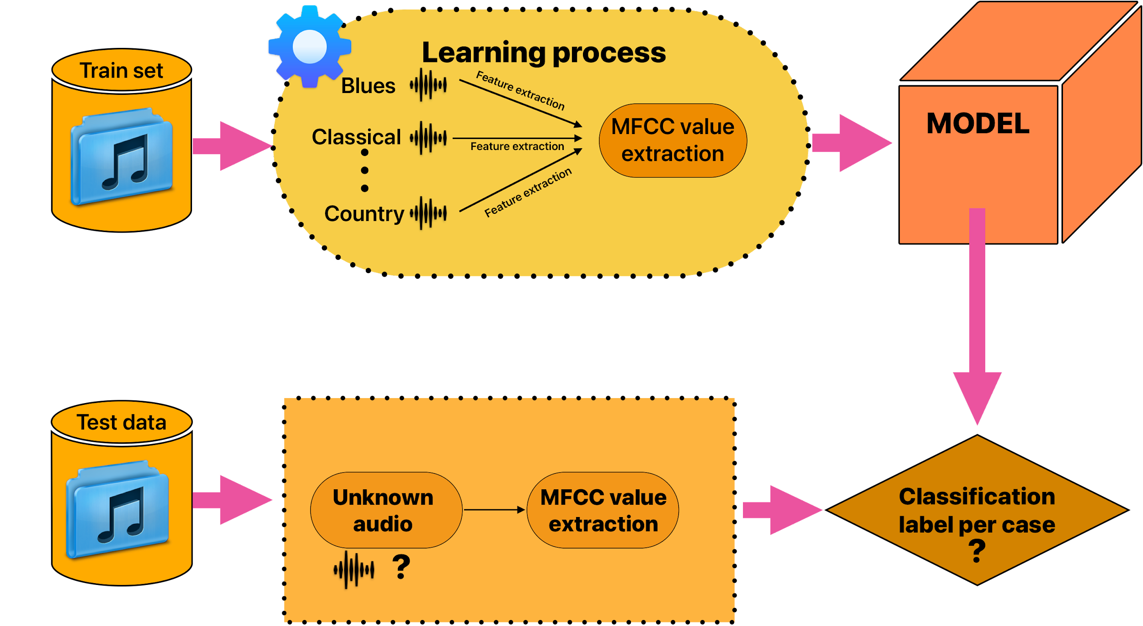
5. System Design

Slide 10
6. Technologies and methodologies
Algorithms Used:
CNN
Dataset:
GTZAN (1000 x 9)
Front-End:
HTML(HTML5)
CSS
JavaScript
Back-End:
Django 4.2
Python 3.12.1

Slide 11


7. Implementation

Slide 12
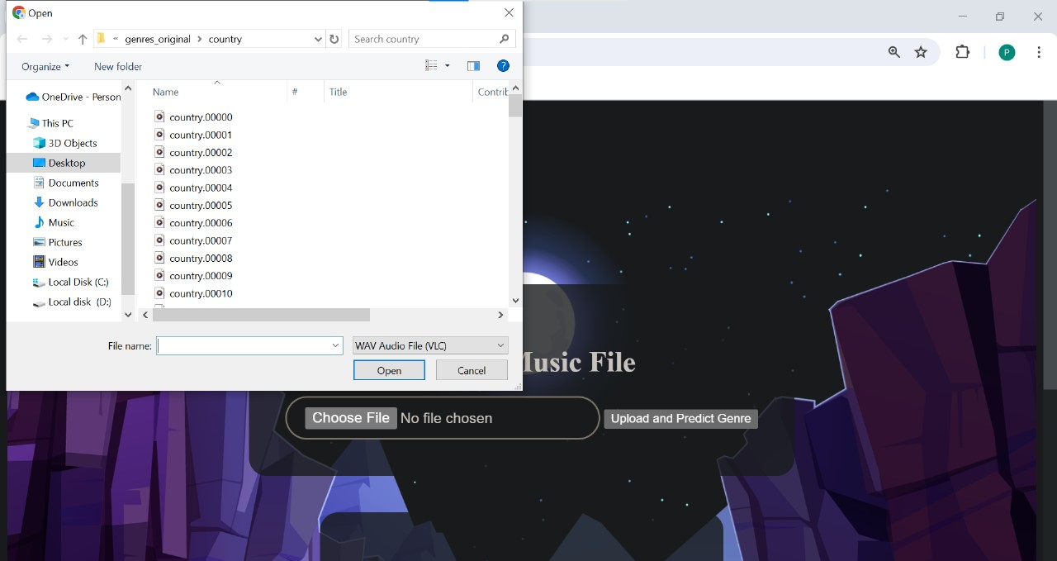

7. Implementation

Slide 13
8. Conclusion
In conclusion, implementing a Music Genre Recognition System using Convolutional Neural Networks (CNN) offers a promising approach for accurately classifying audio signals into distinct genres.
Ultimately, the successful implementation of a CNN-based music genre recognition system can significantly contribute to the organization, recommendation, and personalization of music content in various applications and platforms.
The project not only provides insights into the specific implementation of a CNN-based Music Genre Recognition System but also contributes to the broader discussions surrounding audio signal processing, machine learning, and their applications in the field of music technology.

Slide 14
9. References
[1]Tzanetakis, George, and Perry Cook. "Musical genre classification ofaudio signals." IEEE Transactions on speech and audio processing 10.5 (2002).
[2] Logan, Beth. "Mel Frequency Cepstral Coefficients for Music Modeling."ISMIR. 2000.
[3] Fu, Z., Lu, G., Ting, K. M., & Zhang, D. (2011). A survey of audio-based music classification and annotation. IEEE transactions on multimedia, 13(2), 303-319.
[4] Nirmal M R, “Music Genre Classification using Spectrograms”, International Conference on Power, Instrumentation, Control and Computing (PICC) – 2020.
[5] Hareesh Bahuleyan, “Music Genre Classification using Machine Learning Techniques”, arXiv:1804.01149v1 [cs.SD] – 2018.

Slide 15
Thank You...!!

